Slide 1
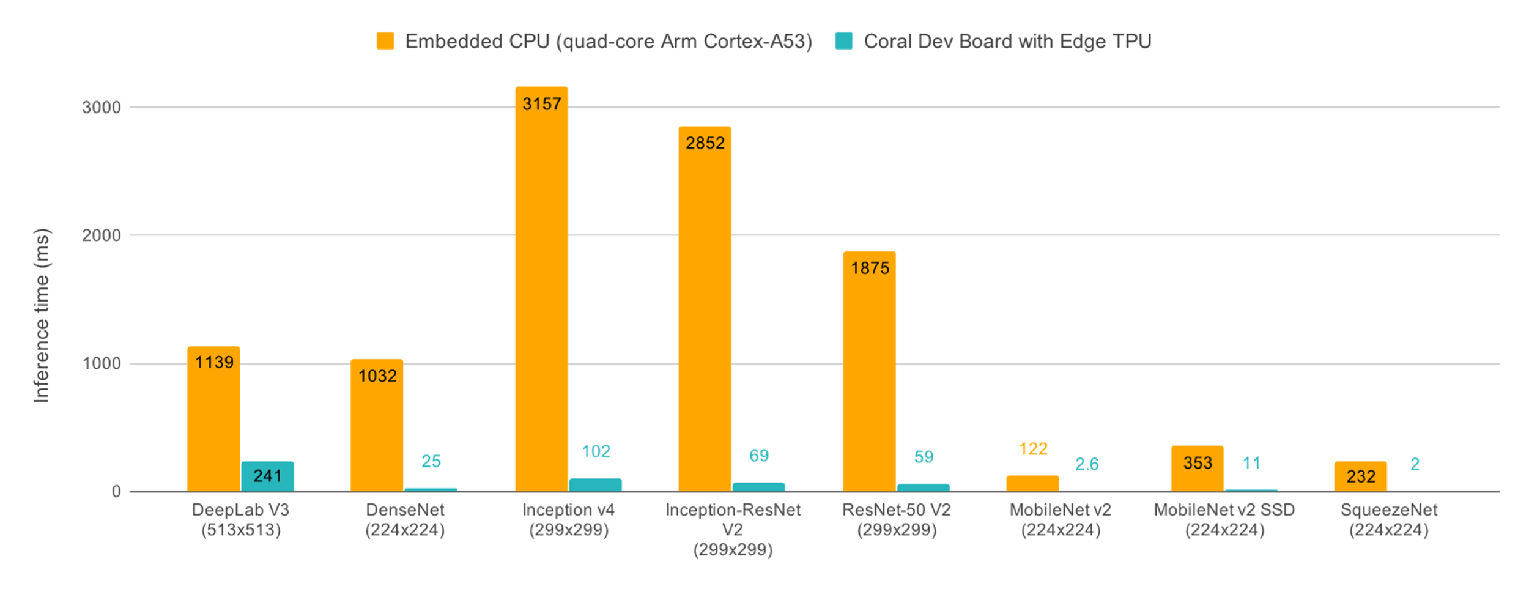
Name: Epres Tamás, MSc student Project type: laboratory project Topic: Evaluation of Neural Network Execution on a Google Edge TPU-Based System
Supervisors: Szinyéri Bence, Sik Dávid
Description:
In recent years, there has been a growing demand for running AI algorithms on embedded systems. However, traditional microcontrollers are not designed to perform large-scale matrix operations efficiently. This problem is addressed by the TPU (Tensor Processing Unit) architecture, which is capable of executing large matrix multiplications while maintaining low power consumption. The goal of my task was to become familiar with the TPU architecture and to implement such an architecture using a hardware description language (SystemVerilog). The attached image illustrates the acceleration capabilities of the TPU.

Slide 2
Experiments
Description:
During my work, I became familiar with fundamental concepts of digital circuits, such as timing concepts, and when to apply combinational or sequential logic circuits.
In addition to this, I studied the basic principles behind the operation of the Google Edge TPU, and I also implemented a simplified architecture using the Vivado environment.
The figure below shows a basic hardware concept of the Google Edge TPU, the systolic array. Its essence is that multiple different execution units receive data from a high-bandwidth memory with proper timing, thereby enabling matrix multiplication.

Slide 3
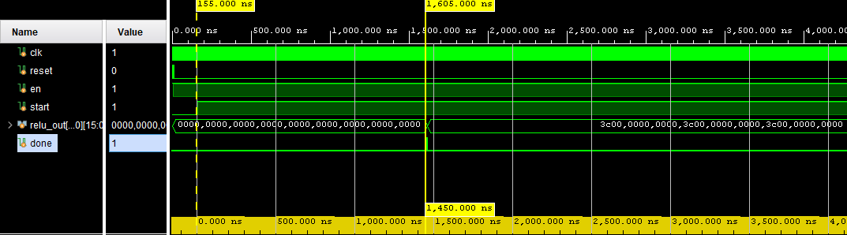
Results & future work
Description:
The image below illustrates the generation of the activation map of a 5×5 image representing the digit "1", demonstrated through a testbench. In this case, a simple Prewitt operator in the x-direction was applied to produce an activation map that can be fed into an MLP layer.
Future work:
Optimization of the implemented architecture, improved allocation of I/O pins, implementation of a serial communication interface as the input channel, testing the system on real hardware, and enabling interoperability with a microcontroller.
{insert picture/gif related to results}

